Slide 1


Tianyu Yang
12/25/22

Slide 2

Outline
Executive Summary
Introduction
Methodology
Results
Conclusion
Appendix

Slide 3
Executive Summary
On this project, the data collected from the SpaceX API and Wikipedia page. Created labels column ‘class’ which classifies successful landings. Using SQL, visualizations, folium maps, and dashboards, explored data. Assembled relevant columns as features. I converted all categorical variables to binary using a single hot encoding. Standardized data and used GridSearchCV to find the best parameters for machine learning models. Visualize the accuracy score of all models..
Four machine learning models were test in the project:
Logistic Regression
Support Vector Machine
Decision Tree Classifier
K Nearest Neighbors.
All four models with similar results as accuracy rate of about 83.33%.

Slide 4
Introduction
Background Info
We all know the Commercial Space Age is Coming. And Space X has best pricing ($62 million vs. $165 million USD) and the main reason is the they have ability to recover part of rocket (Stage 1)
Then Space Y wants to compete with Space X
Problem try to solved
Train a machine learning model to predict successful Stage 1 recovery

Slide 5

Section 1

Slide 6
Methodology
Executive Summary
Data collection methodology:
Combined the data from SpaceX public API and SpaceX Wikipedia page
Perform data wrangling
Classifying true landings as successful and unsuccessful as binary outcomes
Perform exploratory data analysis (EDA) using visualization and SQL
Perform interactive visual analytics using Folium and Plotly Dash
Perform predictive analysis using classification models
Tuned models by using GridSearchCV method

Slide 7
Data Collection
Data collection process involved a combination of API requests from Space X public API and web scraping data from a table in Space X’s Wikipedia entry.
Space X API Data Columns:
FlightNumber, Date, BoosterVersion, PayloadMass, Orbit, LaunchSite, Outcome, Flights, GridFins,
Reused, Legs, LandingPad, Block, ReusedCount, Serial, Longitude, Latitude
Wikipedia Webscrape Data Columns:
Flight No., Launch site, Payload, PayloadMass, Orbit, Customer, Launch outcome, Version Booster, Booster landing, Date, Time

Slide 8
Data Collection – SpaceX API
Request (Space X APIs)
.JSON file and Lists( Json_normalize to DataFrame data)
Filter data
Checking the missing value and replace it with the mean
GitHub URL: https://github.com/T1anyuYang/IBM-Final/blob/main/Data%20Collection%20%E2%80%93%20SpaceX%20API.ipynb

Slide 9
Data Collection - Scraping
GitHub URL: https://github.com/T1anyuYang/IBM-Final/blob/main/Data%20Collection%20-%20Scraping.ipynb
Request Wikipedia html
BeautifulSoup - html5lib Parser
Find launch info html table and setup Dic
Cast dictionary to DataFrame

Slide 10
Data Wrangling
Create a training label with landing outcomes where successful = 1 & failure = 0.
Outcome column has two components: ‘Mission Outcome’ ‘Landing Location’
New training label column ‘class’ with a value of 1 if ‘Mission Outcome’ is True then others 0.
True ASDS, True RTLS, & True Ocean as 1
None None, False ASDS, None ASDS, False Ocean, False RTLS as 0
GitHub URL: https://github.com/T1anyuYang/IBM-Final/blob/main/Data%20Wrangling.ipynb

Slide 11
EDA with Data Visualization
Using EDA on variables Flight Number, Payload Mass, Launch Site, Orbit, Class and Year.
Relevant Plot:
Flight Number vs. Payload Mass Flight Number vs. Launch Site
Payload Mass vs. Launch Site Orbit vs. Success Rate
Flight Number vs. Orbit Payload vs Orbit Success Yearly Trend
Scatter plots, line charts, and bar plots were used to compare relationships between variables to judge if there is a relationship exists so that they could be used in training the machine learning model
GitHub URL: https://github.com/T1anyuYang/IBM-Final/blob/main/EDA%20with%20Data%20Visualization.ipynb

Slide 12
EDA with SQL
Loaded data set into IBM DB2 Database.
Queried using SQL Python integration.
Queries were made to get a better understanding of the dataset.
Get information about launch site names, mission outcomes, various pay load sizes of customers and booster versions, and landing outcomes
GitHub URL:
https://github.com/T1anyuYang/IBM-Final/blob/main/EDA%20with%20SQL%20-%202.ipynb
https://github.com/T1anyuYang/IBM-Final/blob/main/EDA%20with%20SQL.ipynb

Slide 13
Build an Interactive Map with Folium
Folium maps mark Launch Sites, successful and unsuccessful landings, and a proximity example to key locations: Railway, Highway, Coast, and City.
Those allows us to understand why launch sites may be located where they are. Also visualizes successful landings relative to location.
GitHub URL: https://github.com/T1anyuYang/IBM-Final/blob/main/Build%20an%20interactive%20map%20with%20Folium.ipynb

Slide 14
Build a Dashboard with Plotly Dash
Dashboard includes a pie chart and a scatter plot.
Pie chart can be selected to show distribution of successful landings across all launch sites and can be selected to show individual launch site success rates.
Scatter plot takes two inputs: All sites or individual site and payload mass on a slider between 0 and 10000 kg.
The pie chart is used to visualize launch site success rate.
The scatter plot can help us see how success varies across launch sites, payload mass, and
Booster version category.
GitHub URL: https://github.com/T1anyuYang/IBM-Final/blob/main/Build%20a%20Dashboard%20with%20Plotly%20Dash.py

Slide 15
Predictive Analysis (Classification)
Split label column ‘Class’ from dataset
Fit and Transform features
Split the train and test data
When CV=10 find the optimal parameters
Use GridSearchCV on all 4 models
Score each model by test part
Confusion Matrix on 4 models
Use barplot to compare scores of models
GitHub URL: https://github.com/T1anyuYang/IBM-Final/blob/main/Predictive%20analysis%20(Classification).ipynb

Slide 16
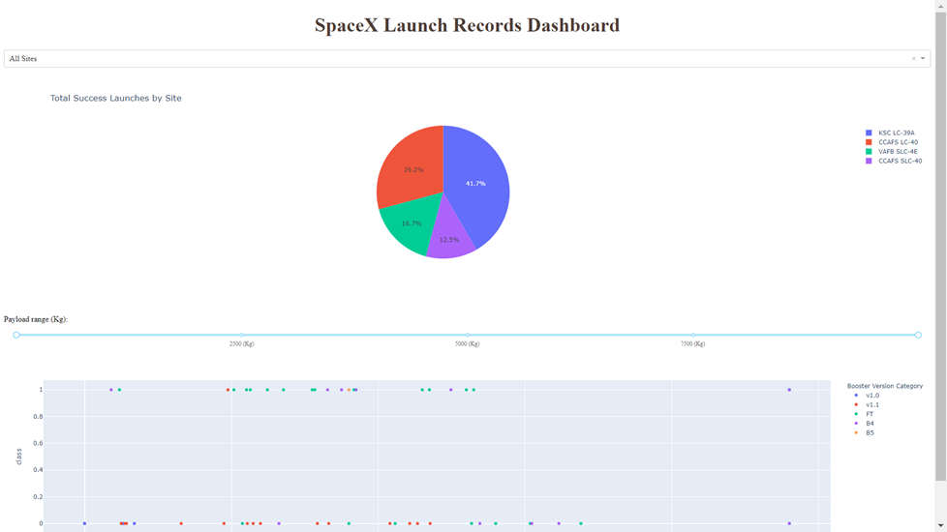
Results
Here is a preview of the Plotly dashboard. The following sides will show the results of EDA with visualization, EDA with SQL, Interactive Map with Folium, and finally the results of our model with about 83% accuracy.

Slide 17

Section 2

Slide 18
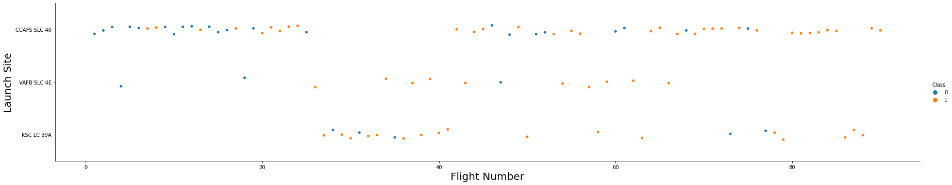
Flight Number vs. Launch Site
Flight Number vs. Launch Site
An increase in success rate over time.
CCAFS appears to be the main launch site as it has the most volume.

Slide 19
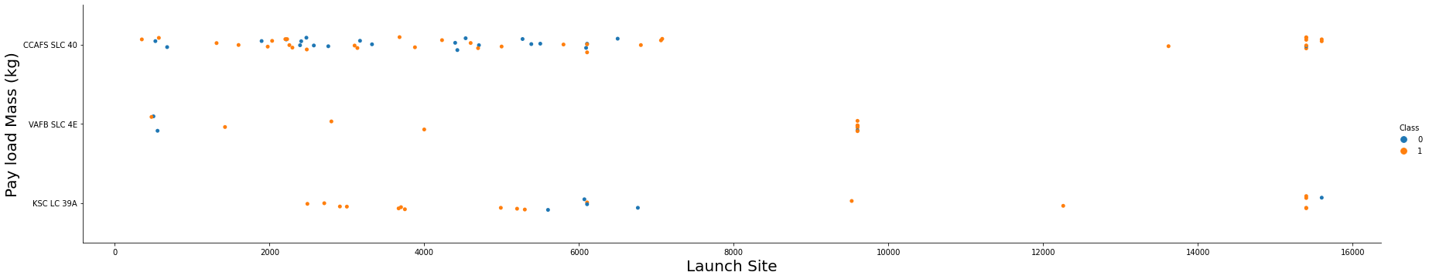
Payload vs. Launch Site
Payload vs. Launch Site
Payload mass appears to fall mostly between 0-6000 kg. Different launch sites also seem to use different payload mass.

Slide 20
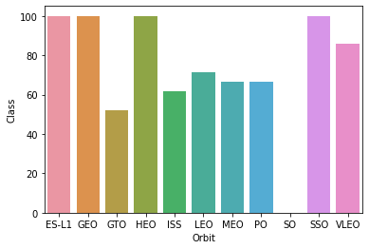
Success Rate vs. Orbit Type
ES-L1, GEO, HEO have 100% success rate (sample sizes in parenthesis) SSO has 100% success rate
VLEO has decent success rate and attempts
GTO has the around 50% success rate but largest sample and SO has 0% success rate

Slide 21
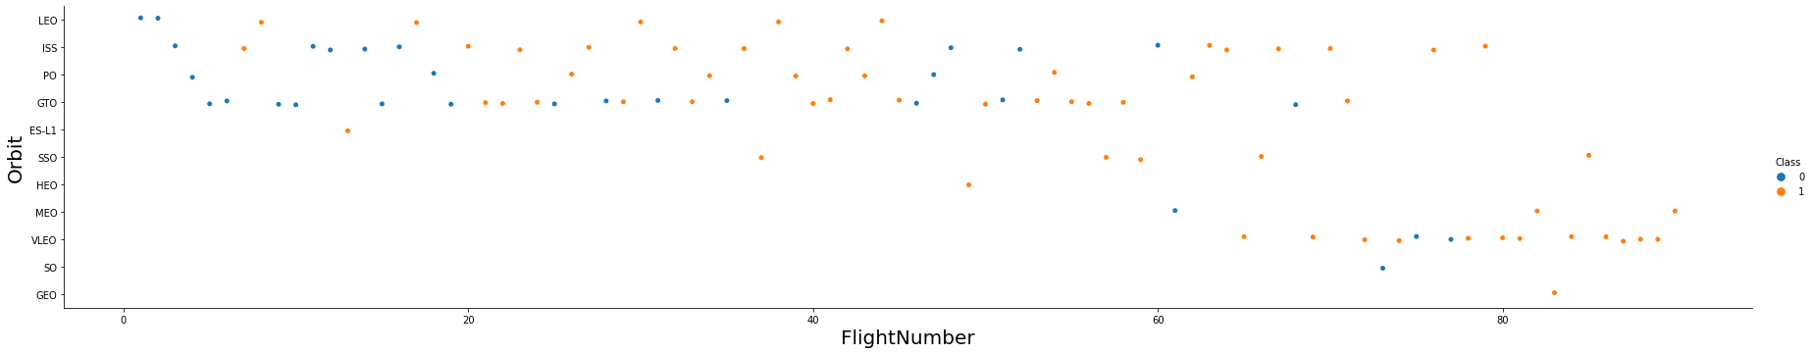
Flight Number vs. Orbit Type
Flight number vs. Orbit type
Launch Orbit preferences changed over Flight Number. Launch Outcome seems to correlate with this preference.
SpaceX started with LEO orbits which saw moderate success LEO and returned to VLEO in recent launches SpaceX appears to perform better in lower orbits or Sun-synchronous orbits

Slide 22
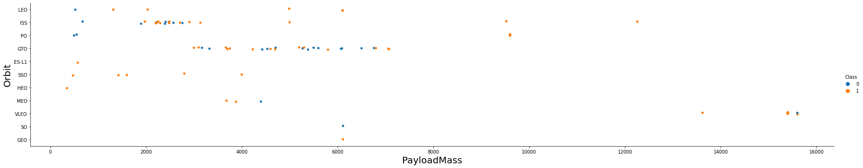
Payload vs. Orbit Type
Payload vs. orbit type
Payload mass seems to correlate with orbit
LEO and SSO seem to have relatively low payload mass
The other most successful orbit VLEO only has payload mass values in the higher end of the range

Slide 23
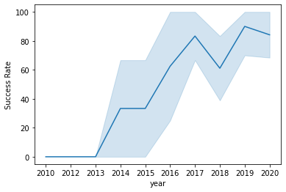
Launch Success Yearly Trend
Success generally increases over time since 2013 with a slight dip in 2018
Success in recent years at around 80%

Slide 24
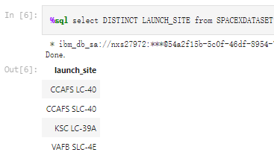
All Launch Site Names
CCAFS SLC-40 and CCAFSSLC-40 likely all represent the same
launch site with data entry errors.
CCAFS LC-40 was the previous name. Likely only 3 unique launch_site values: CCAFS SLC-40, KSC LC-39A, VAFB SLC-4E

Slide 25
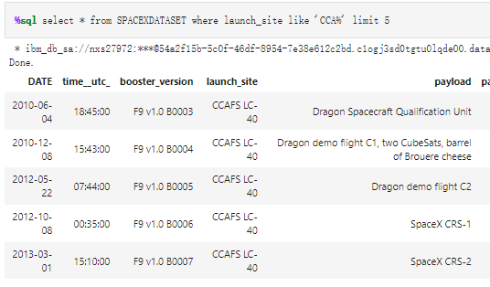
Launch Site Names Begin with 'CCA'
First five entries in database with Launch Site name beginning with CCA.

Slide 26
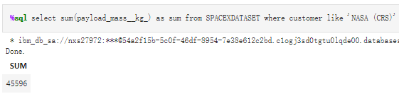
Total Payload Mass
Calculate the total payload carried by boosters from NASA
sums the total payload mass in kg where NASA was the customer.

Slide 27
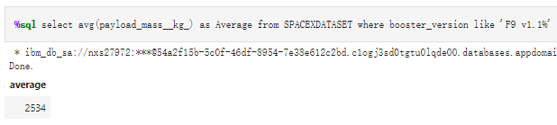
Average Payload Mass by F9 v1.1
Calculate the average payload mass carried by booster version F9 v1.1
Calculates the average payload mass or launches which used booster version F9 v1.1

Slide 28

First Successful Ground Landing Date
Find the dates of the first successful landing outcome on ground pad

Slide 29
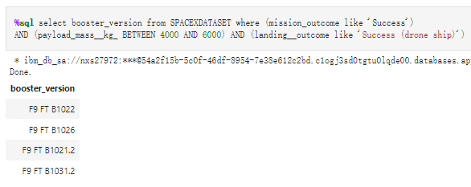
Successful Drone Ship Landing with Payload between 4000 and 6000
List the names of boosters which have successfully landed on drone ship and had payload mass greater than 4000 but less than 6000

Slide 30
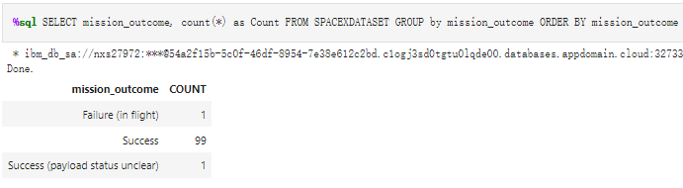
Total Number of Successful and Failure Mission Outcomes
Calculate the total number of successful and failure mission outcomes

Slide 31
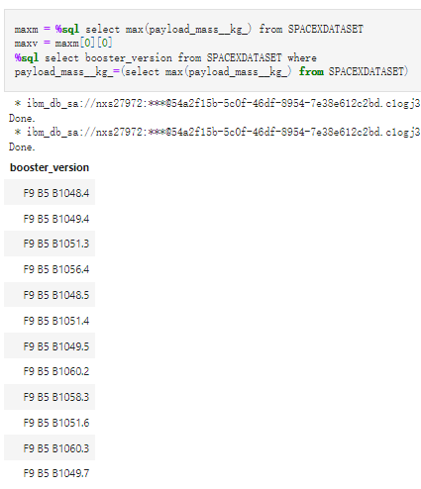
Boosters Carried Maximum Payload
List the names of the booster which have carried the maximum payload mass

Slide 32
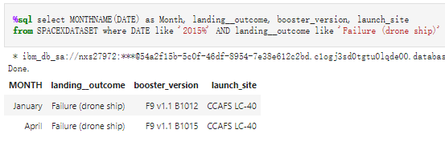
2015 Launch Records
List the failed landing_outcomes in drone ship, their booster versions, and launch site names for in year 2015

Slide 33
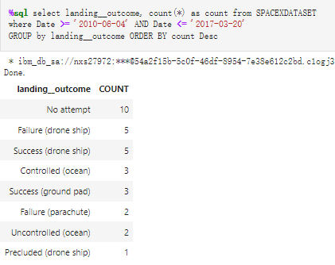
Rank Landing Outcomes Between 2010-06-04 and 2017-03-20
Rank the count of landing outcomes (such as Failure (drone ship) or Success (ground pad)) between the date 2010-06-04 and 2017-03-20, in descending order

Slide 34

Section 3

Slide 35
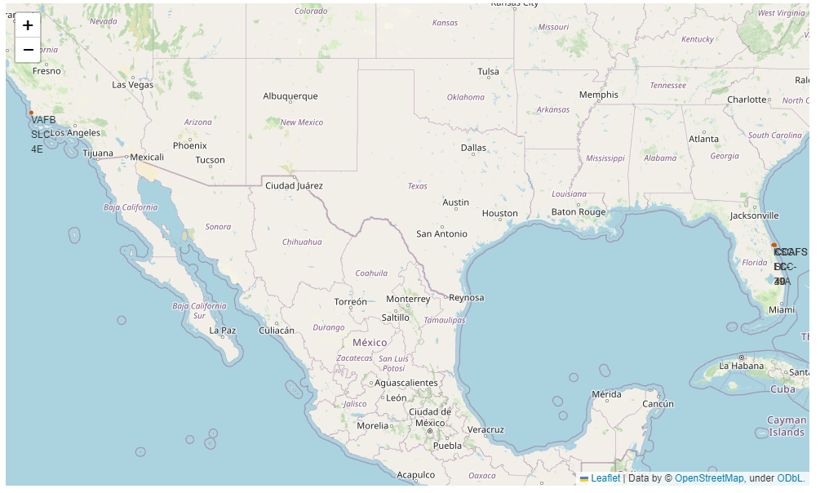
Launch Site Locations
The left map shows all launch sites relative US map.

Slide 36
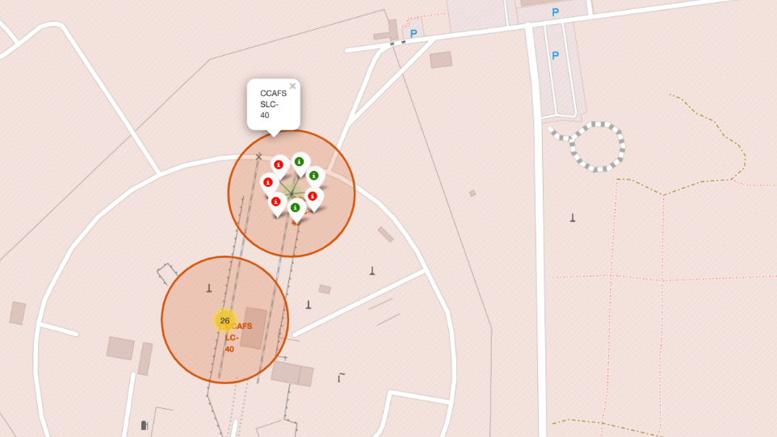
Color-Coded Launch Markers
Clusters on Folium map can be clicked on to display each successful landing (green icon) and failed landing (red icon).

Slide 37
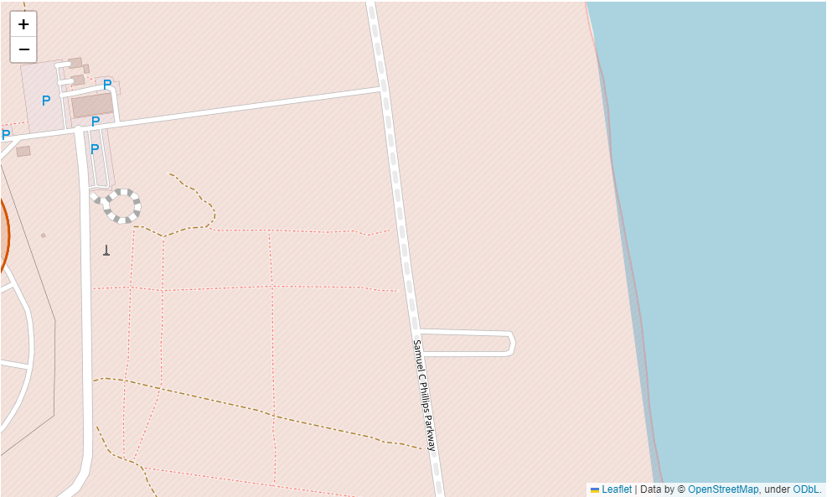
Railway on map

Slide 38

Section 4

Slide 39

Payload Mass vs. Success vs. Booster Version Category
Plotly dashboard has a Payload range selector. However, this is set from 0-10000 instead of the max Payload of 15600. Class indicates 1 for successful landing and 0 for failure. Scatter plot also accounts for booster version category in color and number of launches in point size. In this particular range of 0-6000, interestingly there are two failed landings with payloads of zero kg.

Slide 40
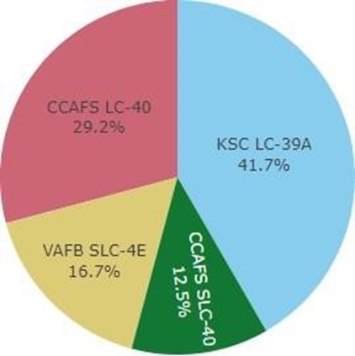
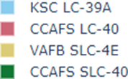
Successful Launches Across Launch Sites
This is the distribution of successful landings across all launch sites. CCAFS LC-40 is the old name of CCAFS SLC-40 so CCAFS and KSC have the same amount of successful landings, but a majority of the successful landings where performed before the name change. VAFB has the smallest share of successful landings. This may be due to smaller sample and increase in difficulty of launching in the west coast

Slide 41
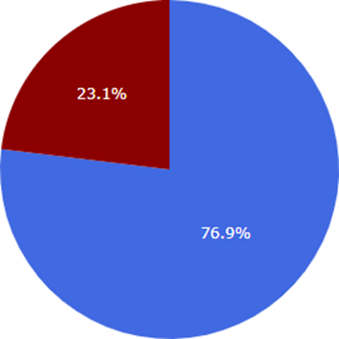
Highest Success Rate Launch Site
KSC LC-39A has the highest success rate with 10 successful landings and 3 failed landings

Slide 42

Section 5

Slide 43
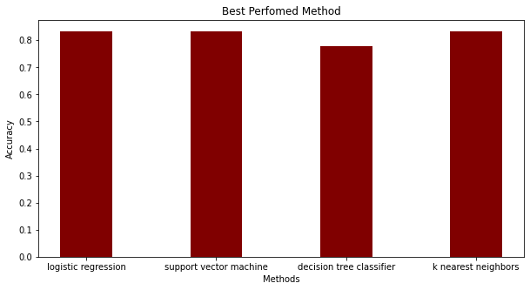
Classification Accuracy
All models except the DT had virtually the same accuracy on the test set closs 83.33% accuracy. It should be noted that test size is small at only sample size of 18.
This can cause large variance in accuracy results, such as those in Decision Tree Classifier model in repeated runs.

Slide 44
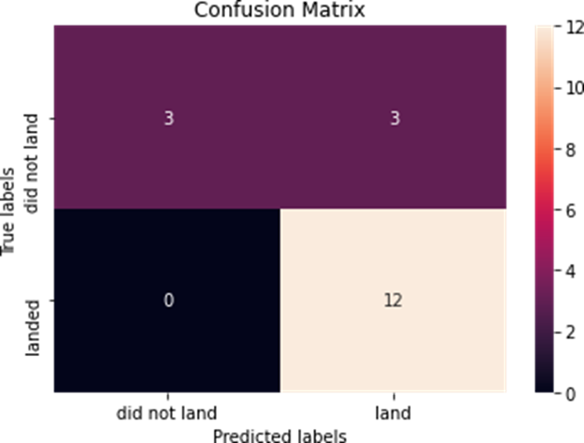
Confusion Matrix
Since majority models performed the same for the test set, the confusion matrix is the same across all models. The models predicted 12 successful landings when the true label was successful landing.
The models predicted 3 unsuccessful landings when the true label was unsuccessful landing.
The models predicted 3 successful landings when the true label was unsuccessful landings (false positives). Our models over predict successful landings.

Slide 45
Conclusions
Our task: to develop a machine learning model for Space Y who wants to bid against SpaceX
The goal of model is to predict when Stage 1 will successfully land to save ~$100 million USD
Used data from a public SpaceX API and web scraping SpaceX Wikipedia pageWe created a machine learning model with an accuracy of 83%
Allon Mask of SpaceY can use this model to predict with relatively high accuracy whether a launch will have a successful Stage 1 landing before launch to determine whether the launch should be made or not
If possible more data should be collected to better determine the best machine learning model and improve accuracy

Slide 46
Appendix
All support from IBM Data Science from Coursera
Thank you so much and have a good day!

Slide 47


